Slide 1
Lecture 18
Queuing Models

Slide 2
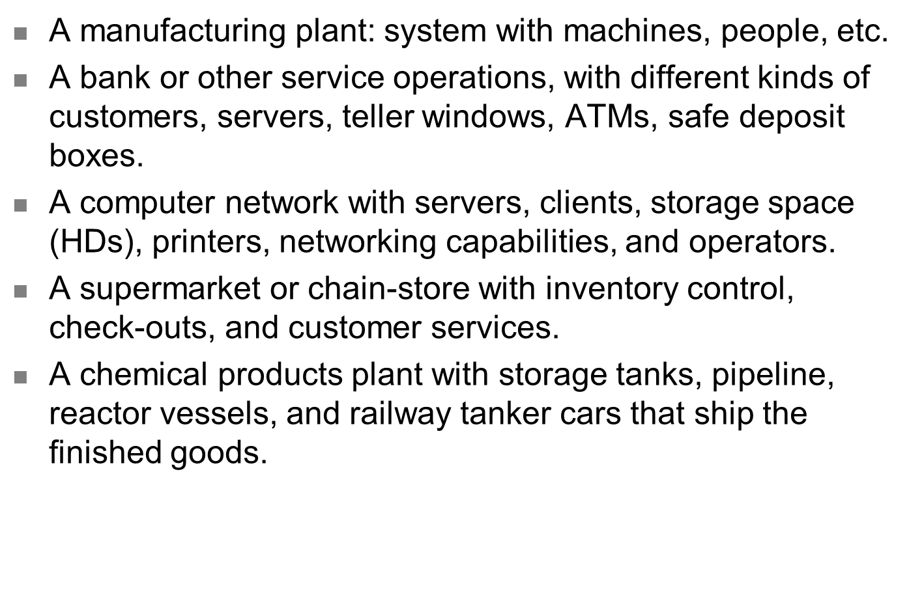
Queuing Models
A manufacturing plant: system with machines, people, etc.
A bank or other service operations, with different kinds of customers, servers, teller windows, ATMs, safe deposit boxes.
A computer network with servers, clients, storage space (HDs), printers, networking capabilities, and operators.
A supermarket or chain-store with inventory control, check-outs, and customer services.
A chemical products plant with storage tanks, pipeline, reactor vessels, and railway tanker cars that ship the finished goods.

Slide 3
Characteristics of a Queuing System
The queuing system is determined by:
Arrival characteristics
Queue characteristics
Service facility characteristics

Slide 4
Arrival Characteristics
Size of the arrival population – either infinite or limited
Arrival distribution:
Either fixed or random
Either measured by time between consecutive arrivals, or arrival rate
The Poisson distribution is often used for random arrivals

Slide 5
Poisson Distribution
λ = the average arrival rate per time unit
P(x) = the probability of exactly x arrivals occurring during one time period
P(x) = e^{-λ} λ^{x}
x!

Slide 6
Behavior of Arrivals
Most queuing formulas assume that all arrivals stay until service is completed
Balking refers to customers who do not join the queue
Reneging refers to customers who join the queue but give up and leave before completing service

Slide 7
Queue Characteristics
Queue length (max possible queue length) – either limited or unlimited
Service discipline
Usually FIFO (First In First Out)
LIFO (Last In First Out)
Priority queues
Random

Slide 8
Service Facility Characteristics
Configuration of service facility
Number of servers (or channels)
Number of phases (or service stops)
Service distribution
The time it takes to serve 1 arrival
Can be fixed or random
Exponential distribution is often used

Slide 9
Measuring Queue Performance
ρ = utilization factor (probability of all
servers being busy)
L_{q} = average number in the queue
L = average number in the system
W_{q} = average waiting time
W = average time in the system
P₀ = probability of 0 customers in system
P_{n} = probability of exactly n customers in system

Slide 10
Kendall’s Notation
A / B / s
A = Arrival distribution
(M for Poisson, D for deterministic, and G for general)
B = Service time distribution
(M for exponential, D for deterministic, and G for general)
S = number of servers

Slide 11
Models Covered
Name (Kendall Notation) | Example
Simple system (M / M / 1) | Customer service desk in a store
Multiple server (M / M / s) | Airline ticket counter
Constant service (M / D / 1) | Automated car wash
General service (M / G / 1) | Auto repair shop
Limited population (M / M / s / ∞ / N) | An operation with only 12 machines that might break

Slide 12
Single Server Queuing System (M/M/1)
Poisson arrivals
Arrival population is unlimited
Exponential service times
All arrivals wait to be served
λ is constant
μ > λ (average service rate > average arrival rate)
Have we seen this before?

Slide 13
Operating Characteristics for M/M/1 Queue
Average server utilization
ρ = λ / μ
Average number of customers waiting
L_{q} = λ²
μ(μ – λ)
Average number in system
L = L_{q} + λ / μ

Slide 14
Average waiting time
W_{q} = L_{q} = λ
λ μ(μ – λ)
Average time in the system
W = W_{q} + 1/ μ
Probability of 0 customers in system
P₀ = 1 – λ/μ
Probability of exactly n customers in system
P_{n} = (λ/μ )^{n} P₀

Slide 15
Single Server Queuing System (M/M/1/K)
Poisson arrivals
Arrival population is unlimited
Exponential service times
All arrivals wait to be served
λ is constant
μ > λ
System can hold a maximum capacity of K
Have we seen this before?

